Slide 1
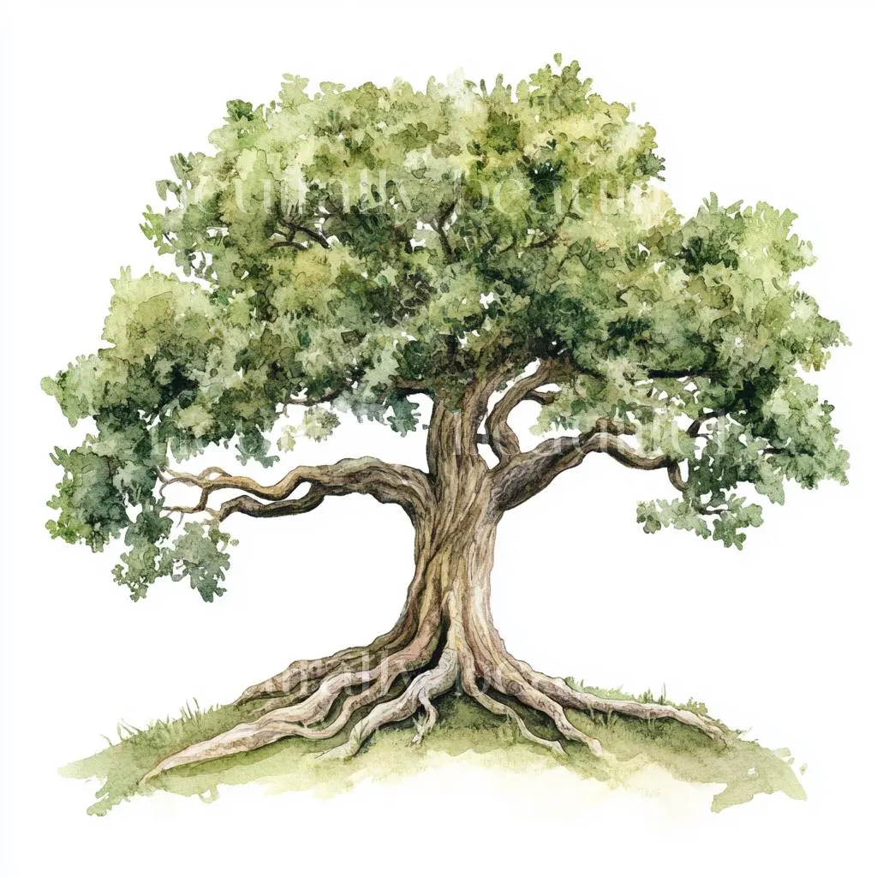
Welcome to
Beech Class (Y3/4) with Mrs.Blow

Slide 2
Our curriculum
As a mixed class, we will ensure coverage is provided for both year groups through careful planning.
Our National curriculum objectives for English in reading and writing are the same for Y3 and Y4,as they are grouped under LKS2.
Our Maths objectives vary slightly with Y4 taking on a further step into higher numbers. However, we are following Whiterose Maths learning and this is specifically planned for with a Y3/4 scheme of learning, to ensure coverage for all. Activities are tailored accordingly.
Our CUSP curriculum is on a two year rotation to ensure children continue to learn a range of skills so that Y3 and Y4 topics continue to be addressed in science and progress through History/Geography is plotted with the whole school learning a particular key period.

Slide 3


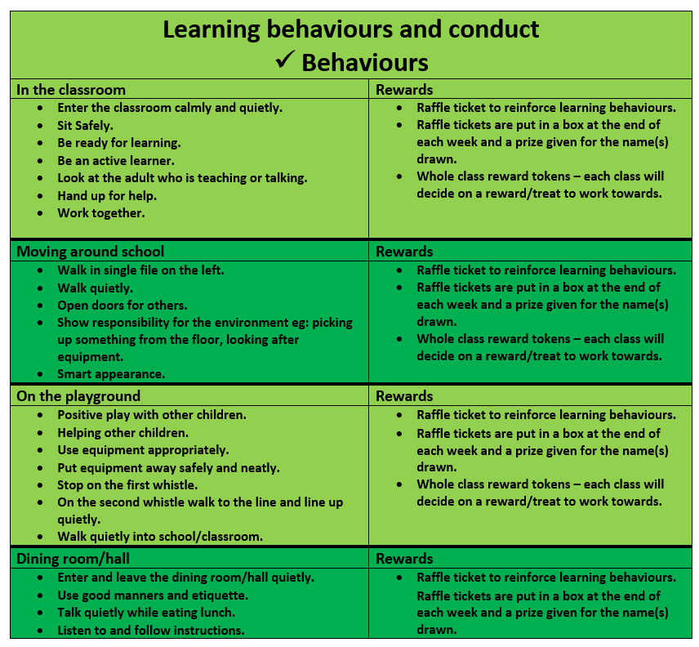
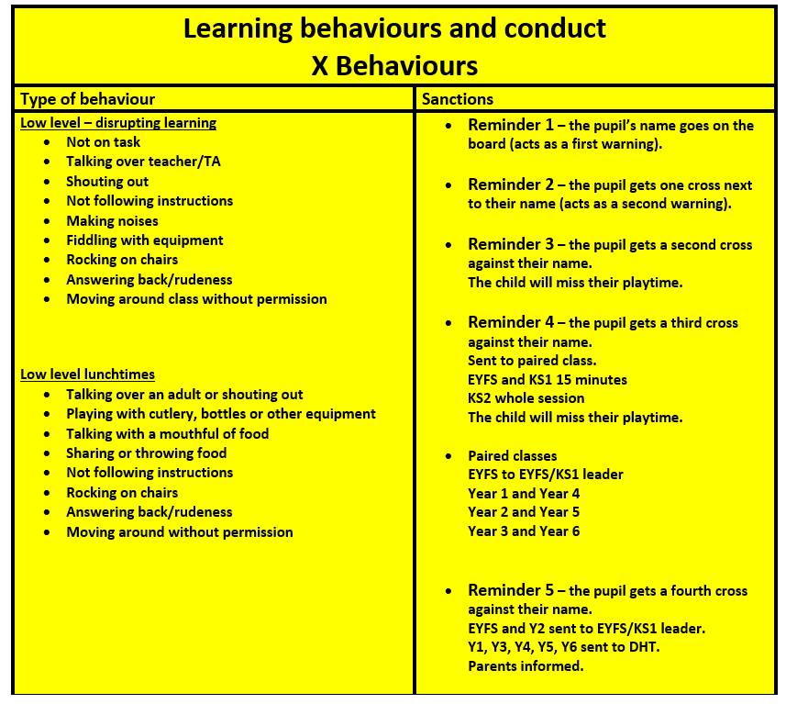
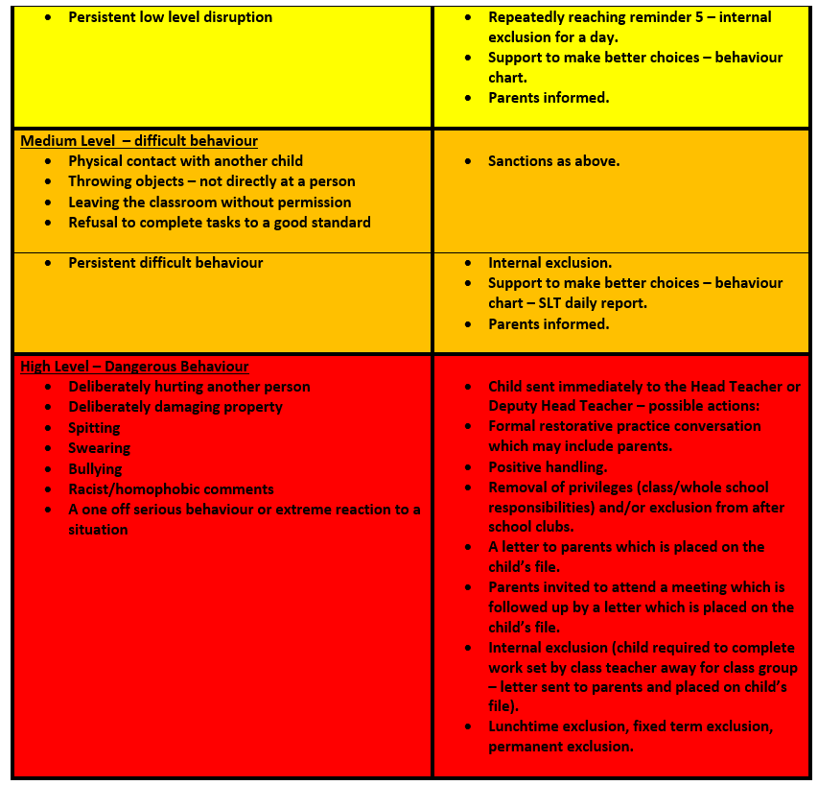
Building positive behaviours

Slide 4
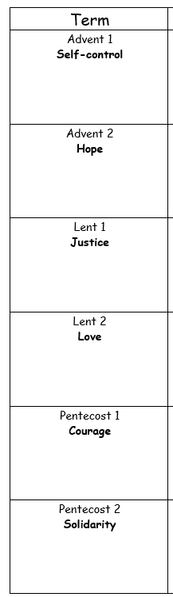

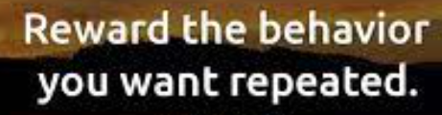
The Learner’s Code of Conduct
This is designed to ensure that learners contribute to a safe and successful learning environment by defining the behaviour and conduct expected from learners. This is outlined through our Catholic Virtues and Values.
Bronze, Silver and Gold level learners. These earn you a badge and privileges.
This year, we are emphasising the importance of home reading and homework with the children. These must also be consistently completed and to a high standard, alongside their conduct code, for pupils to achieve these awards.
This is to encourage a love of learning and build independence.

Slide 5
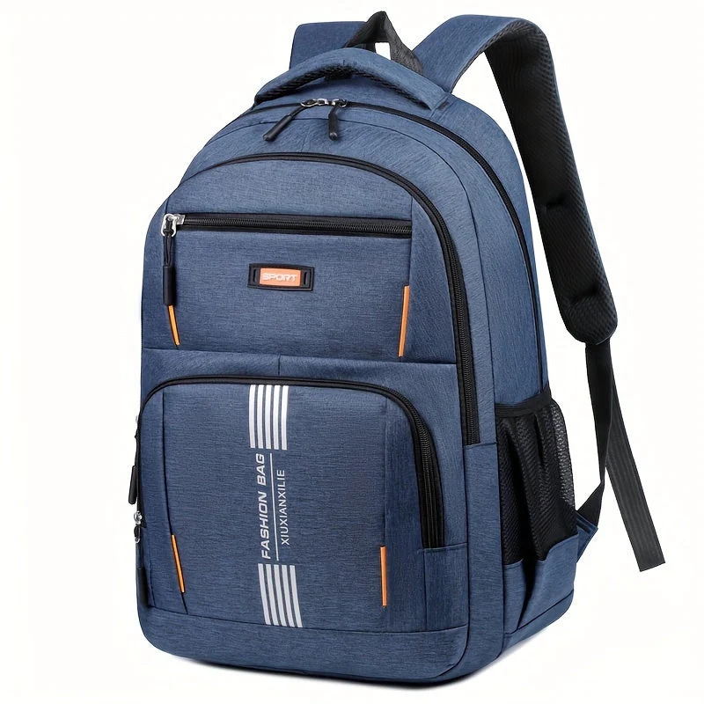

Homework will come home every Friday, so please keep an eye out for this. It is expected to be handed in Thursday.
Any medication will need to be given to the office- please do not put in bags.
Bring your personal organiser and reading book to school in every day.
We now also provide free fruit snacks in school for KS2, but you are welcome to bring in your own too.
We encourage the children to put letters in their book bags, so please check the bag daily.
Don’t forget your packed lunch- this should be healthy. Children can also order hot meals/ pack up through Willoughby foods.
Bring a water bottle in- water only please, which is also named.
Named cardigan/jumper

Slide 6
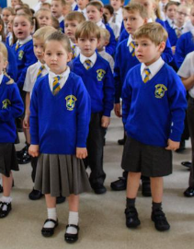
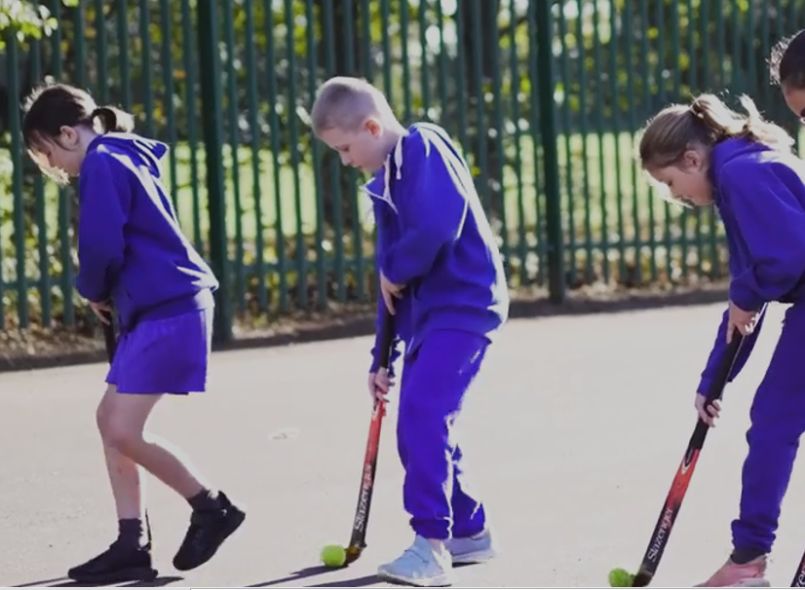
Uniform Check-in
P.E. days Mon and Fri
White t-shirt
Blue shorts
Blue tracksuit
Trainers
Earrings out on P.E. days
Bring kit into school to keep in locker. This will be returned on Friday to clean and back in for Monday.
Grey trousers/ skirt
Blue jumper/cardigan
Black school shoes
Grey or white socks
Tie
Stud earrings only

Slide 7
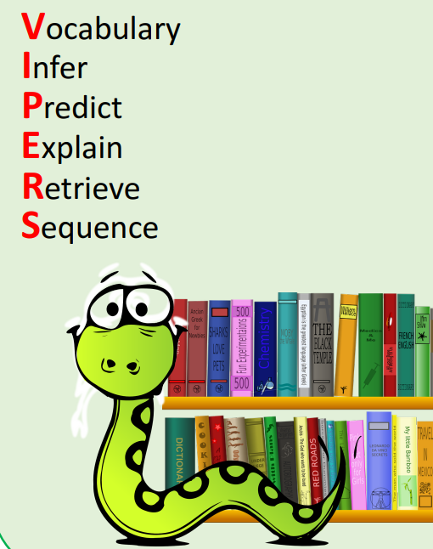
Reading
KS2 pupils use Renaissance Myon to support their reading. This is tailored to the individual and through assessments online completed half termly in school, we can track where a child is and any key areas they need to work on.
There is now a MYON username and password in your children’s personal organisers to access. Please encourage them to complete the quiz when they finish a book as this will check their understanding. We will also keep track of their progress with this.
Books will be checked every Mon, Wed and Fri for changing. This will be monitored so please keep us informed with how your child is reading at home by filling in their reading record.
Children will be encouraged to bring home library books from school library. They will be in line with their ZPD reading ability, so they should be accessible for them to read.
Guided reading will take place weekly for all pupils to develop their comprehension and fluency skills We use VIPERS to support children in their reading skills. Please feel free to use the given sheet to support with questioning at home.

Slide 8

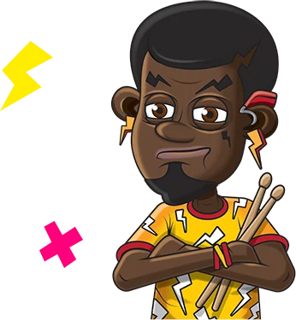
Times Table Rockstars
Your child has a login in for TTRS in their personal organiser.
Please encourage them to login and practice their times tables. The more they do this, the more coins they can earn for their avatar.
The children can challenge their friends in class or play children around the world. They can challenge the teacher too! (Multiplayer-Rock Slam and find their character name) We also presently have a school wide competition on.
This is individually tailored to your child’s ability so as they progress it will move them on, if they are struggling with a particular set of times tables, it will use repetition of these to support until your child has got it and is ready to move on.

Slide 9

Homework Help
Read regularly at least 3 times- write in their reading record.
Homework set on Friday and expected to be handed in the following Thursday.
Homework should be written in pencil only.
Homework should be returned in the folder.
Homework will consist of English spellings and Maths-timetables, then third space learning (online)
A spelling test on given spellings will take place each Friday.
Homework will be based on class learning so should children will be able to access their learning at their level.
Homework should be checked over please.

Slide 10

Sign up to class dojo so you can keep up to date with class messages.
QR CODES can be printed off if you have not yet joined, so please speak with the teacher should you need one.
It is a great way for school and home to communicate with one another, so keep checking in!

Slide 11

Keep in touch!
Please feel to come and talk with me- I am happy to have a quick chat on the door in the morning or if you feel longer is needed, please arrange a time after school.
You are welcome to message on Class dojo. I will reply between school working hours.

