Slide 1
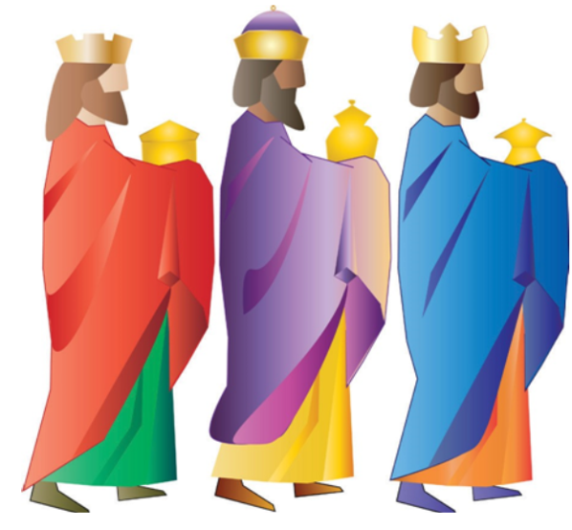
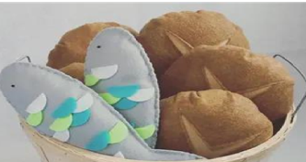
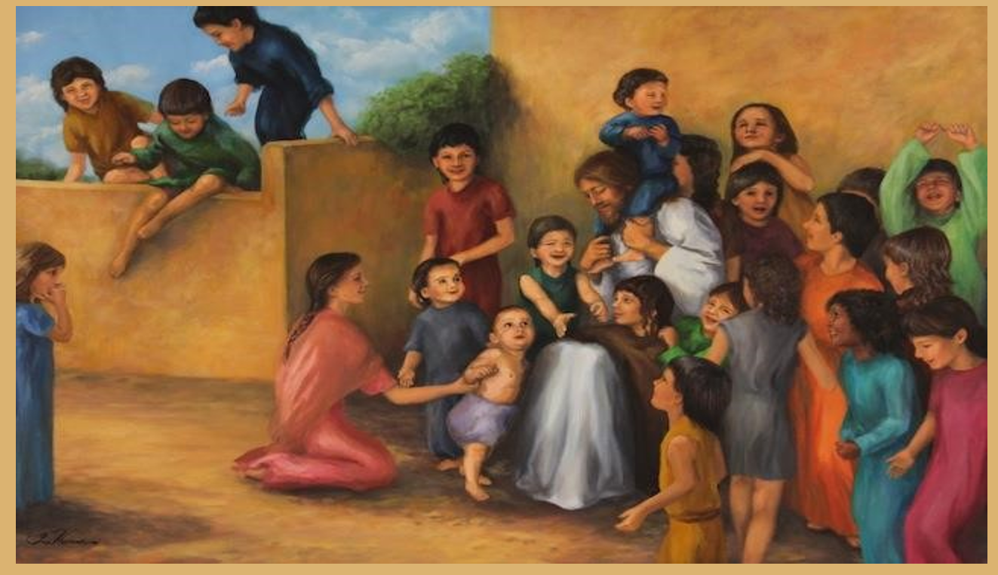
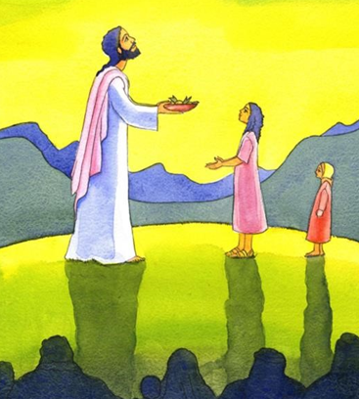
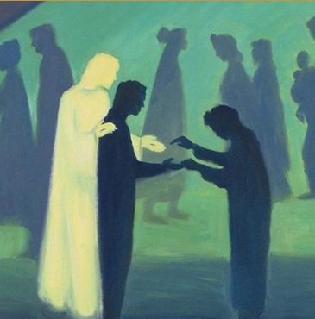
EYFS R.E. Lent 1
Galilee to Jerusalem
Subject Specific Vocabulary
Magi | The “wise men from the East” who came to adore Jesus in Bethlehem.
Jesus | God’s son who was born in Bethlehem.
Gold | A precious metal that is very expensive and a symbol of a King.
Frankincense | An expensive perfume that is burned by high priests as a symbol of lifting our prayers up to God.
Myrrh | A special oil that is used for anointing
Welcome | To meet or speak to someone in a friendly way when they arrive
miracle | An extraordinary and welcome event that cannot be explained. A miracle can only be performed by God.
Sticky Knowledge
God wanted people from very far away to know that Jesus had been born.
The Wise Men wanted to show Mary, Jospeh and Baby Jesus how important Jesus was to them and that they wanted to celebrate His birth with these gifts.
Jesus came for everyone and he welcomes us all.
Jesus notices us and our needs.
Jesus knows that we need to have enough food to live and we should care when others don’t have enough.
The little boy was kind and shared his loaves and fish with everyone. When we help others, we are helping Jesus too. too.

