Slide 1
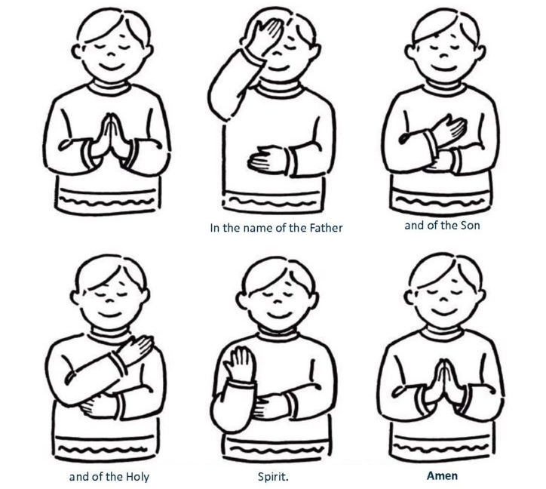
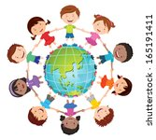
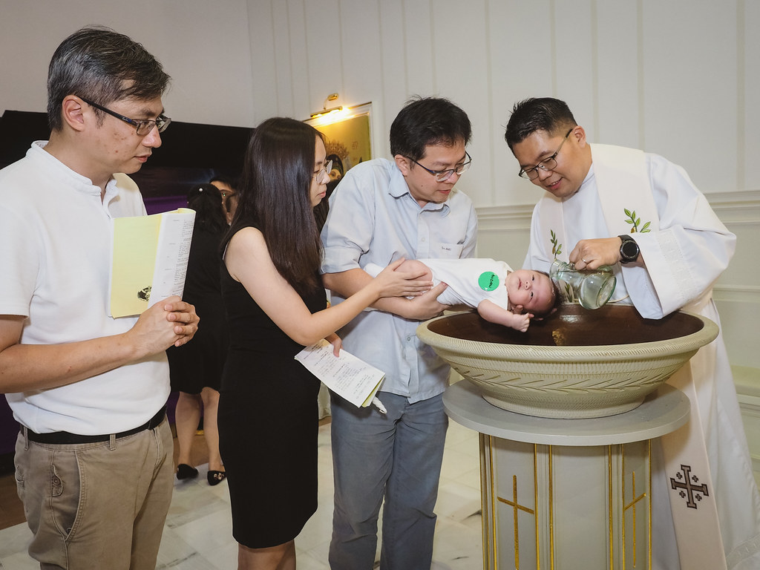

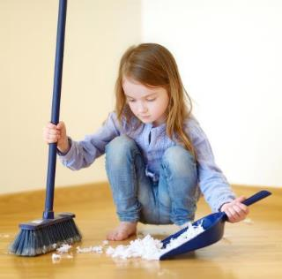
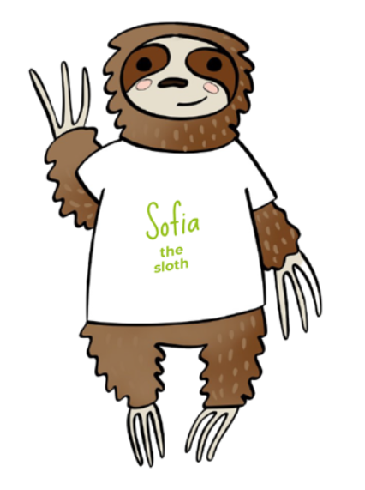
EYFS R.E. Advent 1
Creation and Covenant
Subject Specific Vocabulary
God | The Father of us all. God the Father is one of the three persons in the Holy Trinity. He is everywhere. God is the one that all good in the world comes from. God is love.
creation | The universe and everything in it. God making our world for us all.
world | The earth, together with all of its countries and peoples. God made the world.
stewardship | The job of taking care and looking after something. The job to take care and look after our world.
Baptism | A Sacrament where we are welcomed in to God’s family.
Sign of the Cross | A prayer we say whenever we talk to God.
Core Knowledge
The sign of the cross is a prayer we say whenever we talk to God.
Know that God created the world and all people in it.
God made us all special and unique. He loves us all.
Know that we are blessed and welcomed into God’s family through Baptism.
God asked us to look after his world.

