Slide 2
What Is the Holy Rosary?
The Rosary is a form of prayer used especially in the Catholic Church.
It is a long prayer, based on repetition, with many parts to be remembered and said.
It is named after the string of prayer beads, which some people use to count the parts of the prayer.
The Rosary is very important to Catholics for many reasons, including their devotion to Mary.
The Rosary can be said alone or in groups.
Praying a Rosary for the dead is part of the funeral tradition.

Slide 3
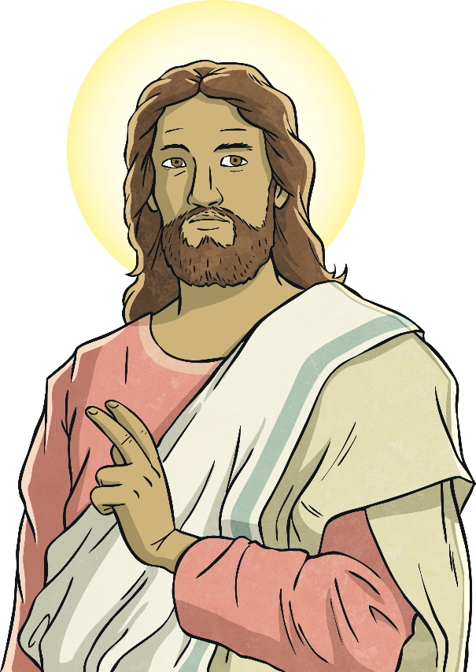
What Is the Purpose of the Rosary?
The most important reason for praying the Rosary is to grow closer to our Savior Jesus Christ. We can grow closer to Jesus every time we pray. The Rosary is especially powerful in strengthening our relationship with the Lord and fostering our devotion to His Sacred Heart.
Another purpose of the Rosary is to help people remember the events in the life of Jesus and to praise God for Him.
The Rosary is a little bit like a history lesson!
The main focus is on Jesus - his birth, life, death, and resurrection.

Slide 4
The Rosary and the Apostles’ Creed
The main parts of the Rosary are:
1. Sign of the Cross
I believe in God,
the Father almighty,
Creator of heaven and earth,
and in Jesus Christ, his only Son, our Lord,
who was conceived by the Holy Spirit,
born of the Virgin Mary,
suffered under Pontius Pilate,
was crucified, died and was buried;
he descended into hell;
on the third day he rose again from the dead;
he ascended into heaven,
and is seated at the right hand of God the Father almighty;
from there he will come to judge the living and the dead.
I believe in the Holy Spirit,
the holy catholic Church,
the communion of saints,
the forgiveness of sins,
the resurrection of the body,
and life everlasting. Amen.
The Our Father Prayer
Our Father, Who art in Heaven; hallowed be Thy name; Thy kingdom come; Thy will be done on Earth as it is in Heaven. Give us this day our daily bread; and forgive us our trespasses as we forgive those who trespass against us, and lead us not into temptation; but deliver us from evil. Amen

Slide 5
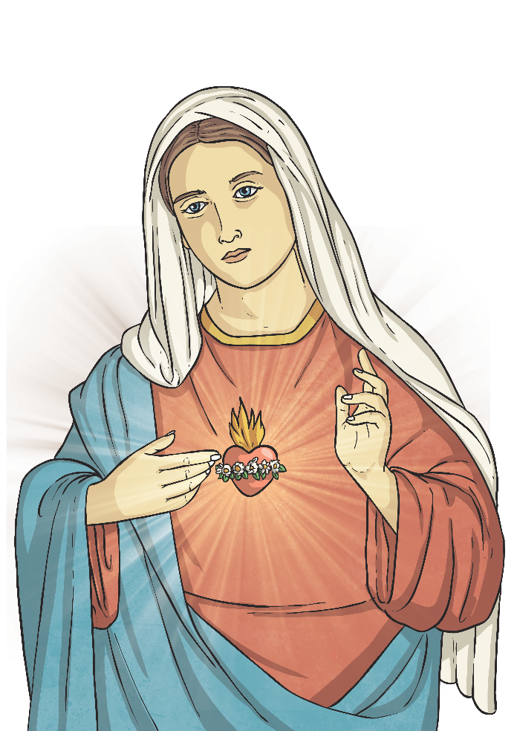
The Rosary
The main parts of the Rosary are:
2. The Our Father
Our Father, Who art in Heaven; hallowed be Thy name. Thy kingdom come; Thy will be done on Earth as it is in Heaven. Give us this day our daily bread; and forgive us our trespasses as we forgive those who trespass against us. And lead us not into temptation; but deliver us from evil. Amen
3. The Hail Mary (three times)
Hail Mary, full of grace, the Lord is with thee. Blessed art thou among women and blessed is the fruit of thy womb, Jesus. Holy Mary, Mother of God, pray for us sinners, and now and at the hour of our death. Amen
4. The Glory Be
Glory be the Father, and to the Son, and to the Holy Spirit, as it was in the beginning, is now, and ever shall be, world without end. Amen
5. The Our Father
6. The Hail Mary (ten times)
7. The Glory Be

Slide 6
What Are Rosary Beads?
The Rosary beads provide a method of keeping track of the different parts of the Rosary Prayer.
The fingers are moved along the beads as the prayers are said.
By not having to keep track of the count mentally, the mind is free to meditate.
The Roman Catholic Rosary is made up of a cross or crucifix, a medal, large beads, and small beads.
Each Rosary has five groups of ten beads. The prayers of the Rosary can also be said using any type of counting device or by counting on the fingers.

Slide 7
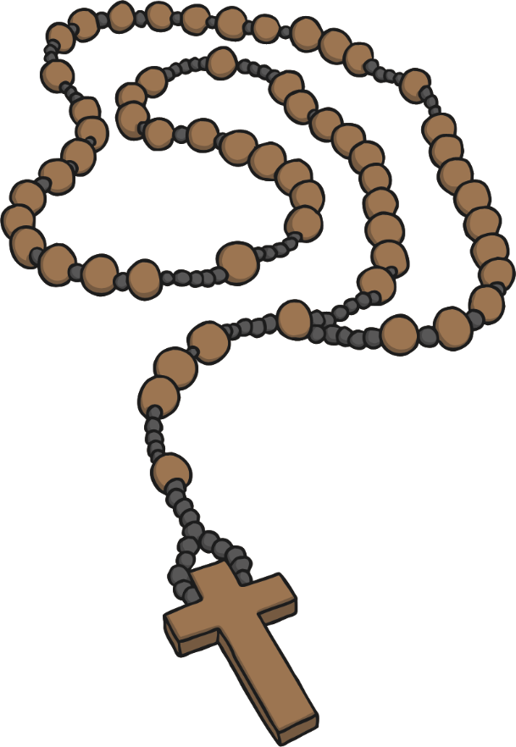
Using The Rosary Beads
1. The Sign of the Cross and The Apostles’ Creed 2. The Our Father Prayer
3. The Hail Mary Prayer (x3)
4. The Glory Be to the Father
5. The Our Father Prayer
6. The Hail Mary Prayer (x10)
7. The Glory Be to the Father
7
6
3
4
5
2
1

Slide 8
Using The Rosary Beads
The Rosary focuses on the life of Christ from the Bible.
During these prayers, people meditate on different aspects of Christ’s life.
The beads of the Rosary are divided into five decades (or sections); each decade represents an event from the life of Christ.
These five events are grouped into a set of four mysteries, each focused on an important part of the life of Christ.
The four mysteries are named after the type of events in that mystery:
Joyful - The Nativity
Luminous - The Baptism of the Lord
Sorrowful - The Crucifixion
Glorious - The Resurrection
What else do you know about Jesus’ life in each of the mysteries?

Slide 9
Scripture Readings
Each mystery of the Rosary is accompanied by a reading from the New Testament.
The reading gives us more detail about the specific mystery and helps us to concentrate on that mystery as we pray.
We read the Scripture passage after announcing the title of the mystery and before praying the prayers for that mystery.

Slide 10
Scripture Readings: The Nativity
For example, for the third Joyful mystery, the Nativity, the reading is:
While they were there, the time came for her to have her child, and she gave birth to her firstborn son. She wrapped him in swaddling clothes and laid him in a manger, because there was no room for them in the inn. Now there were shepherds in that region living in the fields and keeping the night watch over their flock. The angel of the Lord appeared to them and the glory of the Lord shone around them, and they were struck with great fear. The angel said to them, "Do not be afraid; for behold, I proclaim to you good news of great joy that will be for all the people. For today in the city of David a savior has been born for you who is Messiah and Lord. And this will be a sign for you: you will find an infant wrapped in swaddling clothes and lying in a manger."
(Luke 2: 6-12)

Slide 11
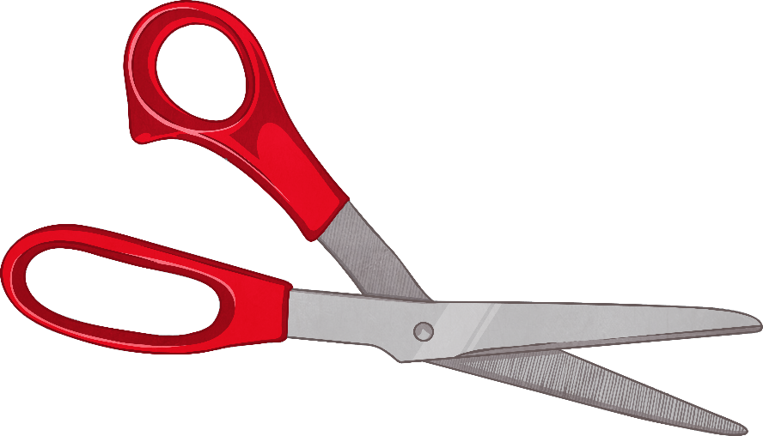
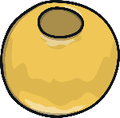
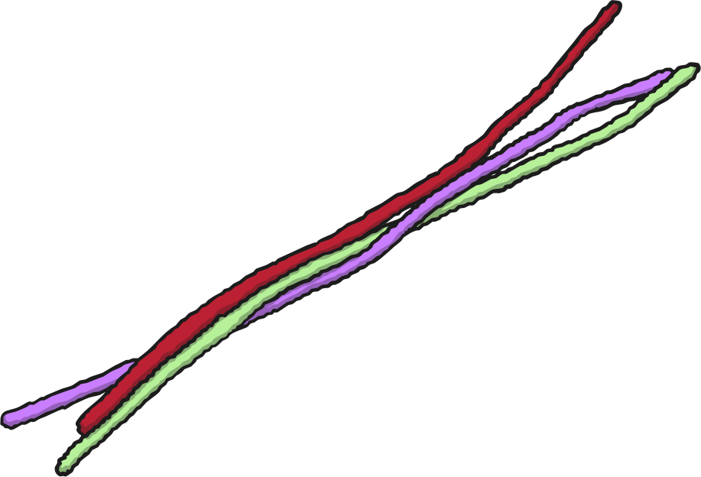
Make Your Own Rosary
You will need:
pipe cleaners
small craft beads
scissors
Place 10 beads of your choice onto a pipe cleaner.
Bring the pipe cleaner around into a circle and twist it shut.
Place on one more bead for the Our Father.
Cut off the extra piece and twist it around to make the cross.
Trim off the extra where necessary.

